Slide 1
VOIP-Voice Over Internet Protocol
AKSHAT PAL
ADITYA PARKHE
ABHINAV K

Slide 2
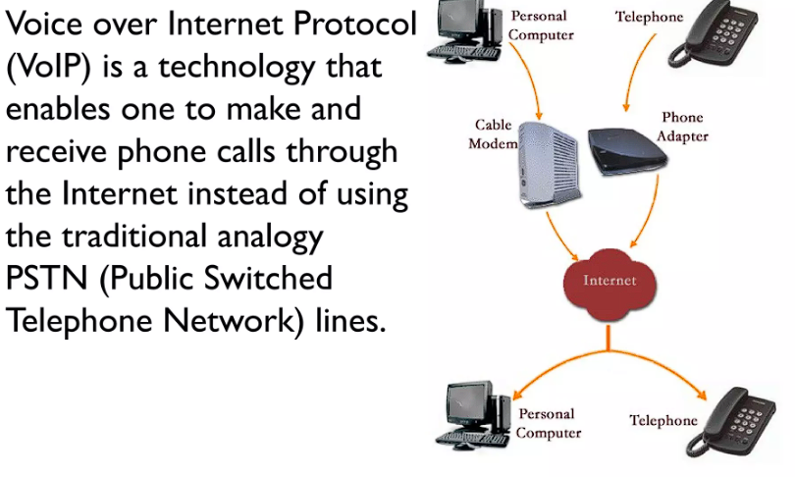
Introduction

Slide 3
VOIP allow users to make calls over LAN or the internet.
This modern technology is capable of converting analog voice signals into digital packets of information.

Slide 4
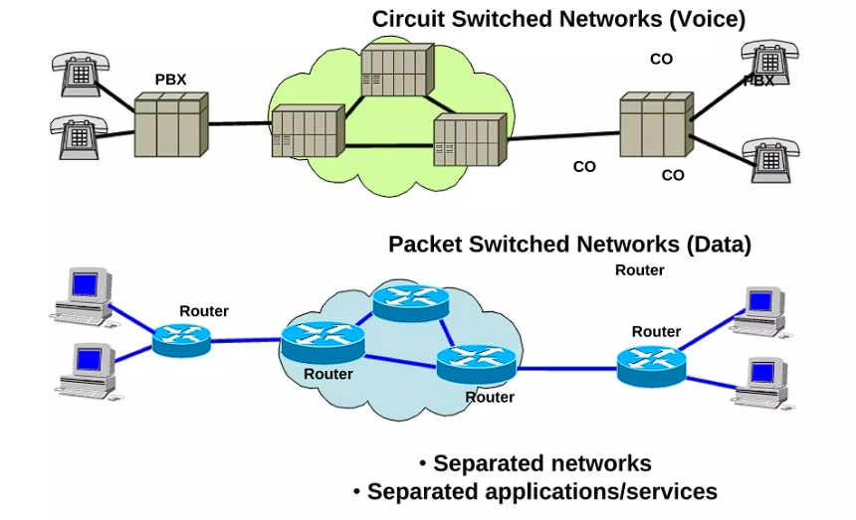

Slide 5
VOIP – How does it work?
Converting the voice signal
ADC (analog to digital)
DAC (digital to analog)
Voice(source) ADC Internet DAC Voice
Transmission of voice traffic in packets

Slide 6
Implementation of VOIP in Cisco Packt Tracer
Creating a network topology using Cisco Packet Tracer.
Connecting Networking devices with Correct cabling.
Configuring Basic device settings.
Creating VLANs and assigning ports VLAN numbers.
Creating both data and voice VLANs and assigning ports VLAN numbers.
Configuring Inter-VLAN Routing on the Routers (router-on-a-stick).
Configuring Dedicated DHCP Server device for Data to provide dynamic IP allocation.
Configuring Routers as DHCP server for Voice to provide IP Phones dynamic IP allocation.
Configuring OSPF as the routing protocol.
Configuring VoIP or Telephony service configuration in all routers.
Configuring Routing for VoIP or Dial peering configuration in all routers.
Host Device Configurations.
Test and Verifying Network Communication.

Slide 7
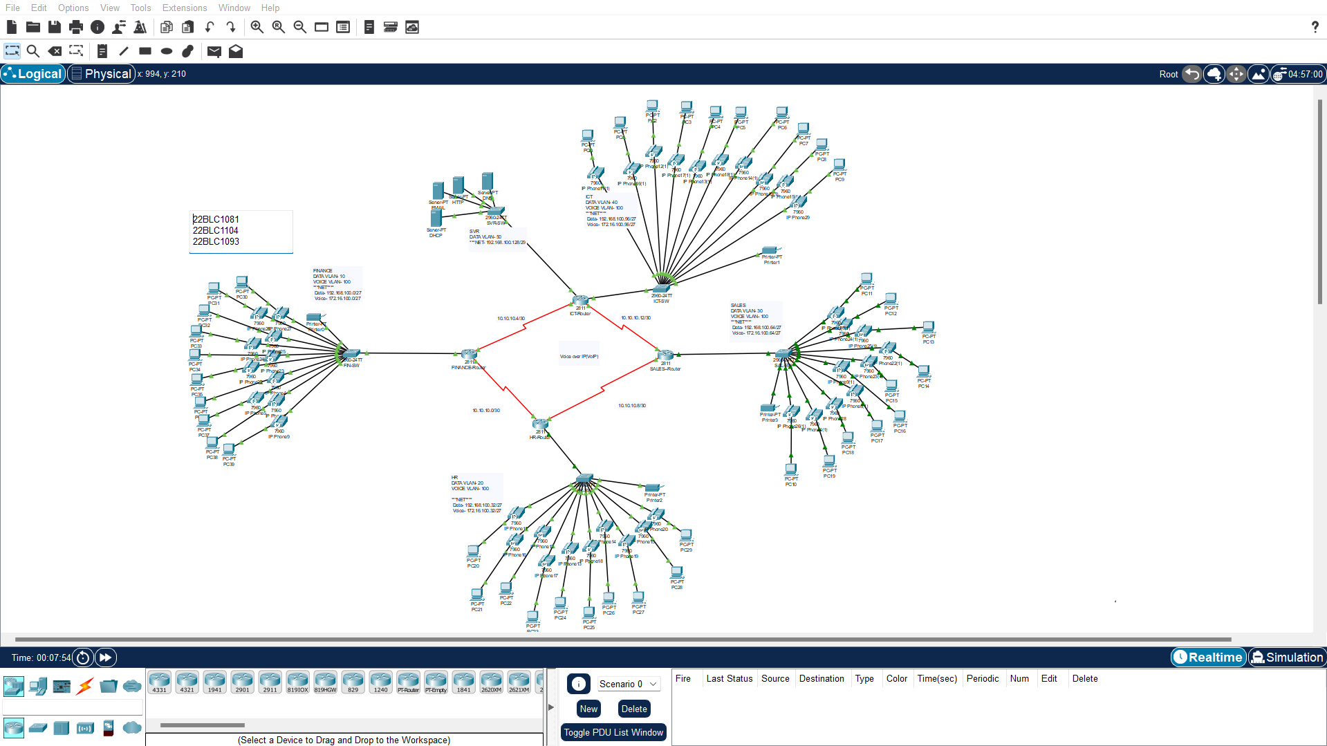

Slide 8
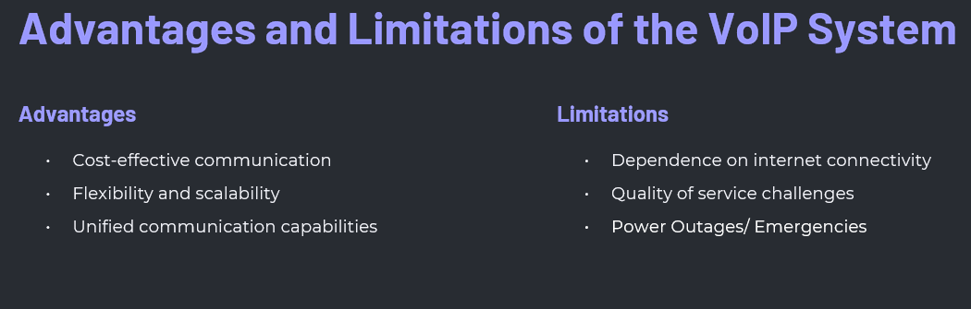

Slide 9
THANK YOU

